Slide 1

Error Recovery Mechanism in Modern Compiler Design Supervisor Research Scholar
Dr.G.Michael S.Divya Prasanna
Professor 192311333
Saveetha School of Engineering Saveetha School of Engineering
Notes:
1
1

Slide 2
AGENDA:
Introduction
Existing Models
Flaws in Existing Model
Proposed Model
Implementation
Results and Discussion
Future Enhancements
Conclusion

Slide 3
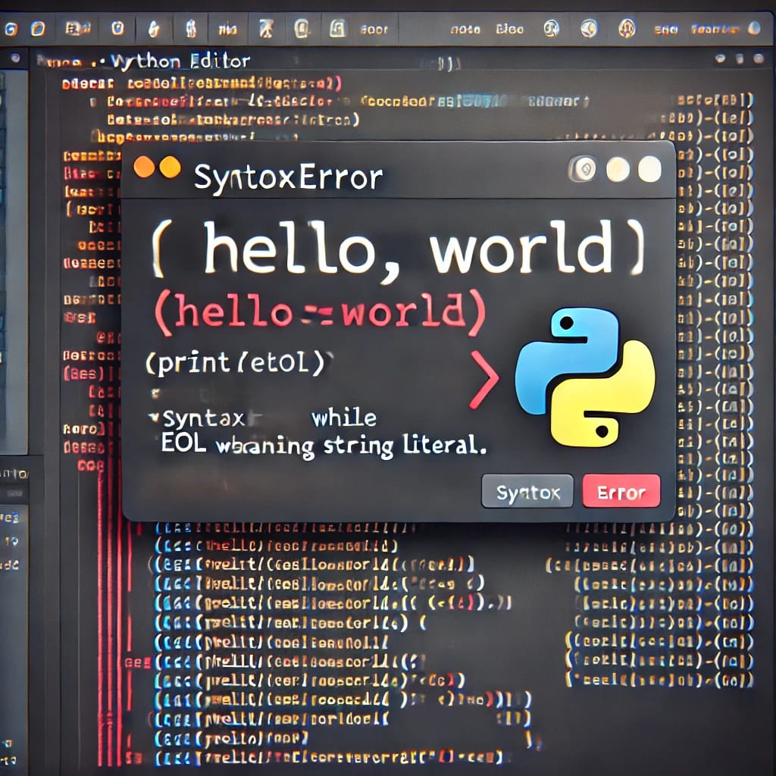
INTRODUCTION:
What is This About?
Compilers turn code into something computers understand.
Errors in code can stop compilers from working.
We want to make compilers stronger and smarter.
Compilers can make your code run faster and use less memory by improving how it’s written, without you having to do it manually.

Slide 4
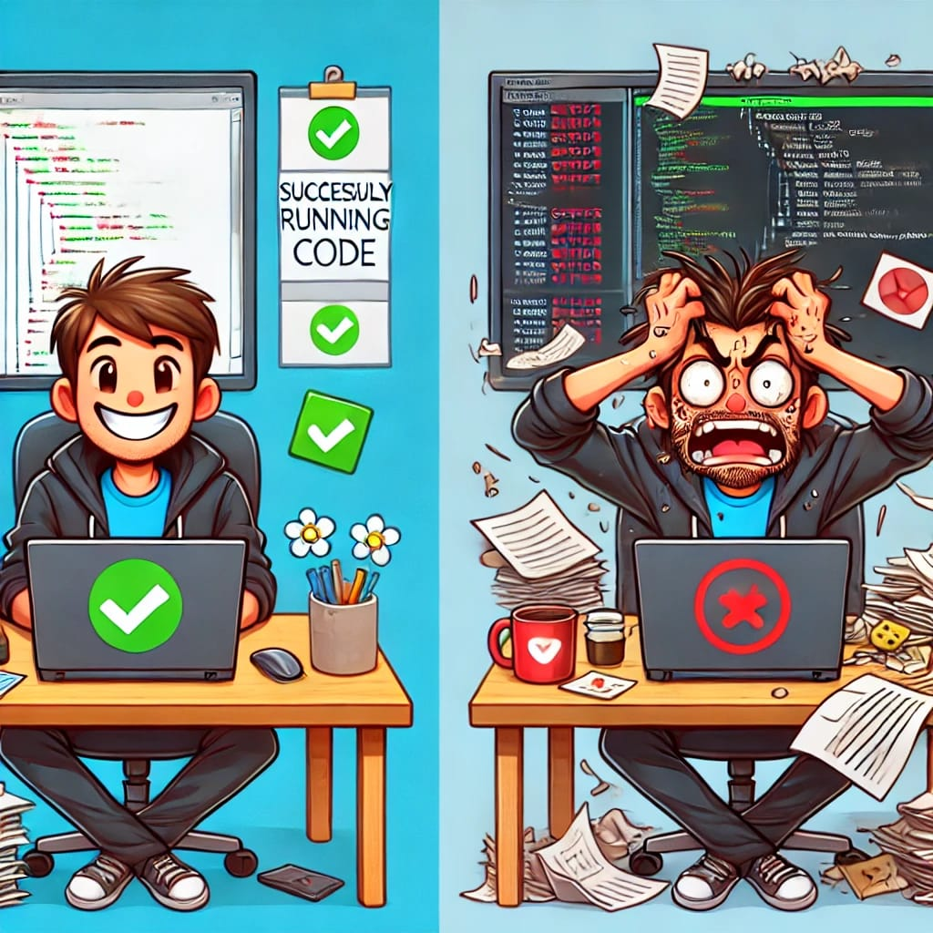
INTRODUCTION:
Why It Matters?
Developers need help fixing mistakes fast.
A good compiler keeps going even with errors.
Our goal: Better error recovery for modern compilers.
So the developers will not be frustrated

Slide 5

APPLICATIONS USED :
GCC (GNU Compiler Collection):
Uses Panic Mode to skip errors and keep going.
Common for C, C++, and more.
Clang:
Fixes small errors with Phrase-Level recovery.
Popular in LLVM projects, good for clear messages.

Slide 6
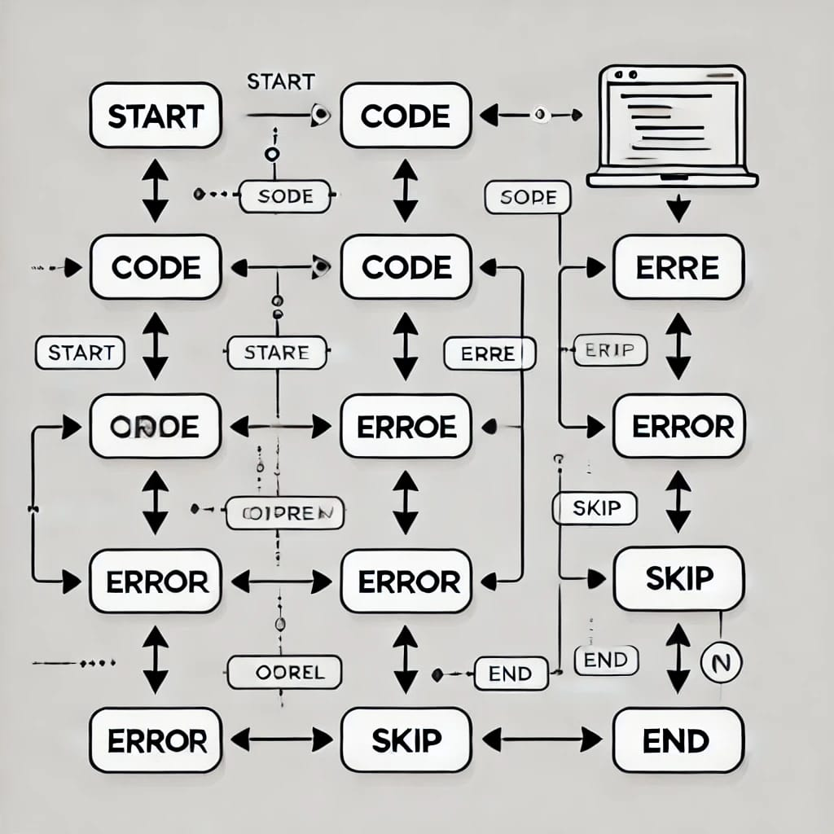
EXISISTING MODELS:
What’s Out There?
Compilers today try to fix errors in different ways
Panic Mode: Skips errors to keep going.
Phrase-Level: Fixes small mistakes in code.

Slide 7
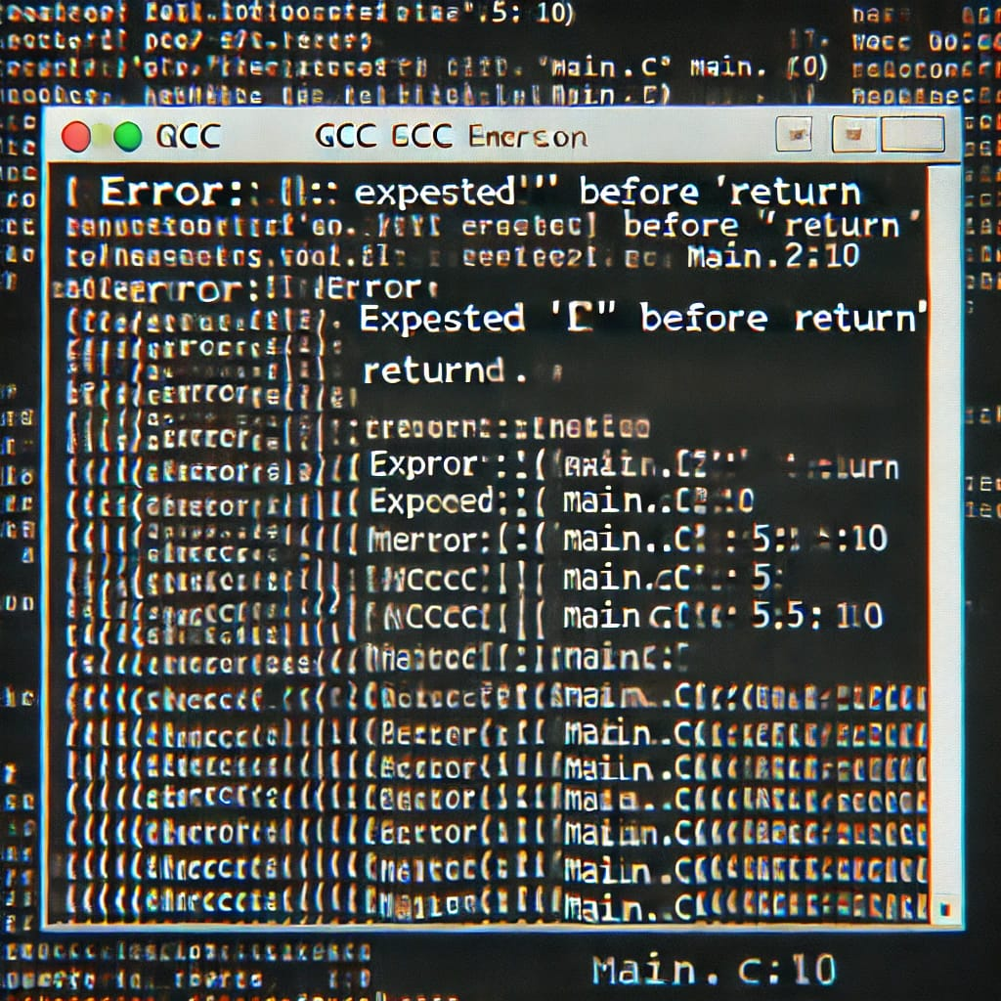
EXISITING MODELS:
Real Examples:
GCC and Clang use these ideas.
They catch errors but don’t always explain well.
Some keep working, some stop too soon.

Slide 8
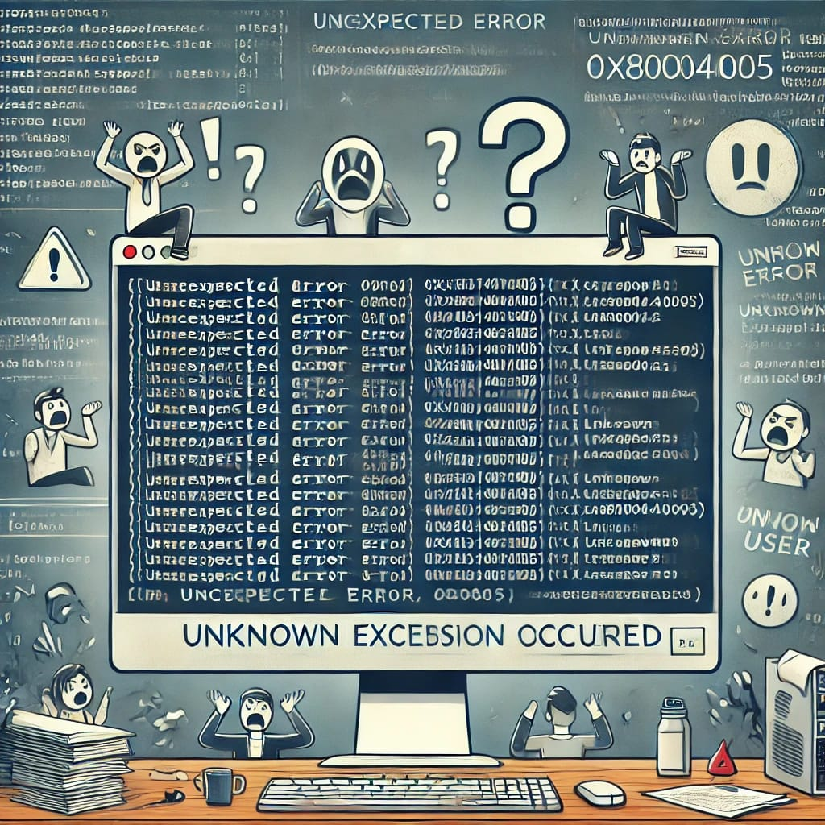
FLAWS IN EXISITING MODELS:
Unclear Error Messages: Compilers often provide vague or overly technical error messages, making it hard for developers to understand and fix issues.
Premature Termination: Compilers stop at the first error, offering limited feedback and requiring multiple recompilations to detect all errors.
Handling Complex Errors: Ambiguous or context-sensitive errors confuse compilers, resulting in misleading or unclear error messages.
Inefficient Semantic Error Recovery: Compilers struggle with semantic errors, providing insufficient context or feedback to accurately diagnose and resolve the issue.

Slide 9

FLAWS IN EXISISTING MODELS:
Why It’s a Problem?
Developers waste time figuring out errors.
Stopping early means less code gets checked.
Bad for big projects with lots of code.

Slide 10
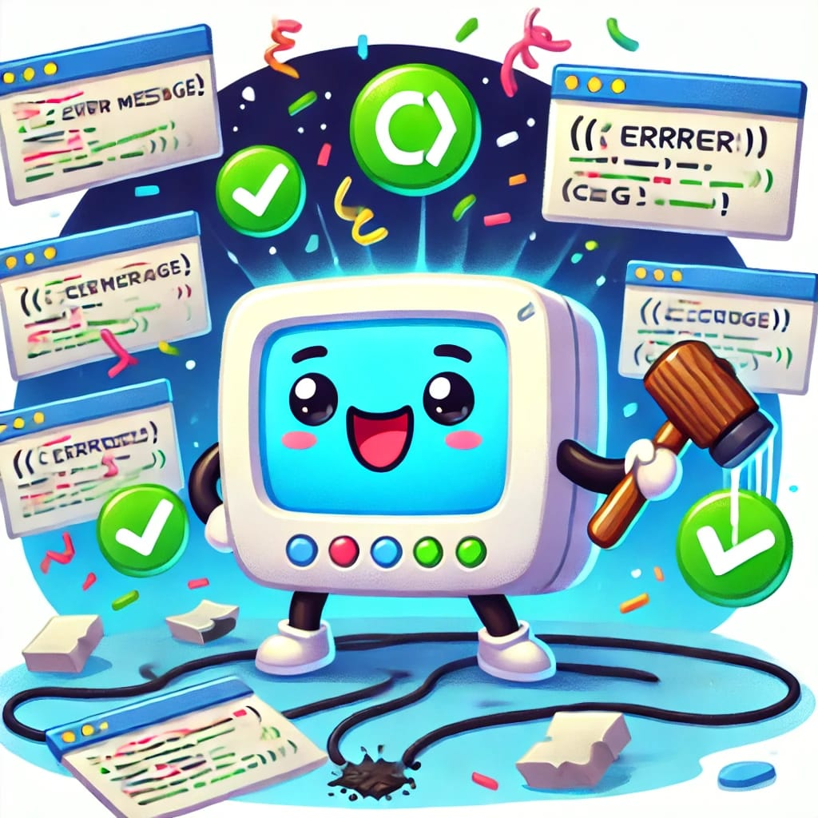
PROPOSED MODEL:
Our New Idea!
We made a smarter way to handle errors.
It finds mistakes and keeps going.
Gives clear messages to help fix code.
Saves Time: Reduces debugging effort with faster error resolution.
Boosts Confidence: Helps coders trust their work with reliable feedback.

Slide 11
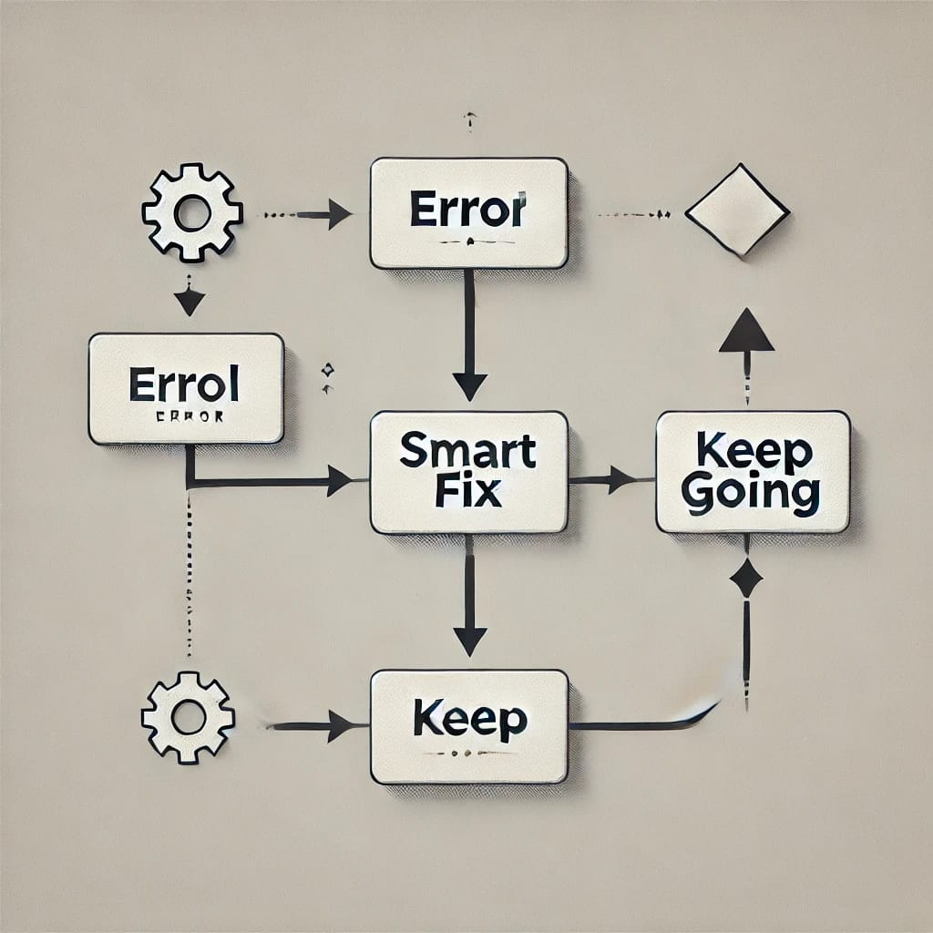
PROPOSED MODEL:
How It’s Different?
Looks at the whole code, not just one part.
Doesn’t give up after one error.
Tells you exactly what’s wrong and why.
Prioritizes Errors: Highlights critical issues first for efficient fixes.
Supports All Levels: Works for beginners and pros with tailored advice.

Slide 12

IMPLEMENTATION:
Tools we used
Built it with [e.g., LLVM or simple tools]: The system was constructed using tools like LLVM (a compiler infrastructure) or basic programming utilities to create an efficient framework. -
Made a system to catch and fix errors: A mechanism was implemented to identify mistakes in the code and automatically correct them for smoother operation.
Tested it on small and big code samples: The system was evaluated using both simple, small-scale code and larger, complex samples to ensure reliability and scalability.

Slide 13
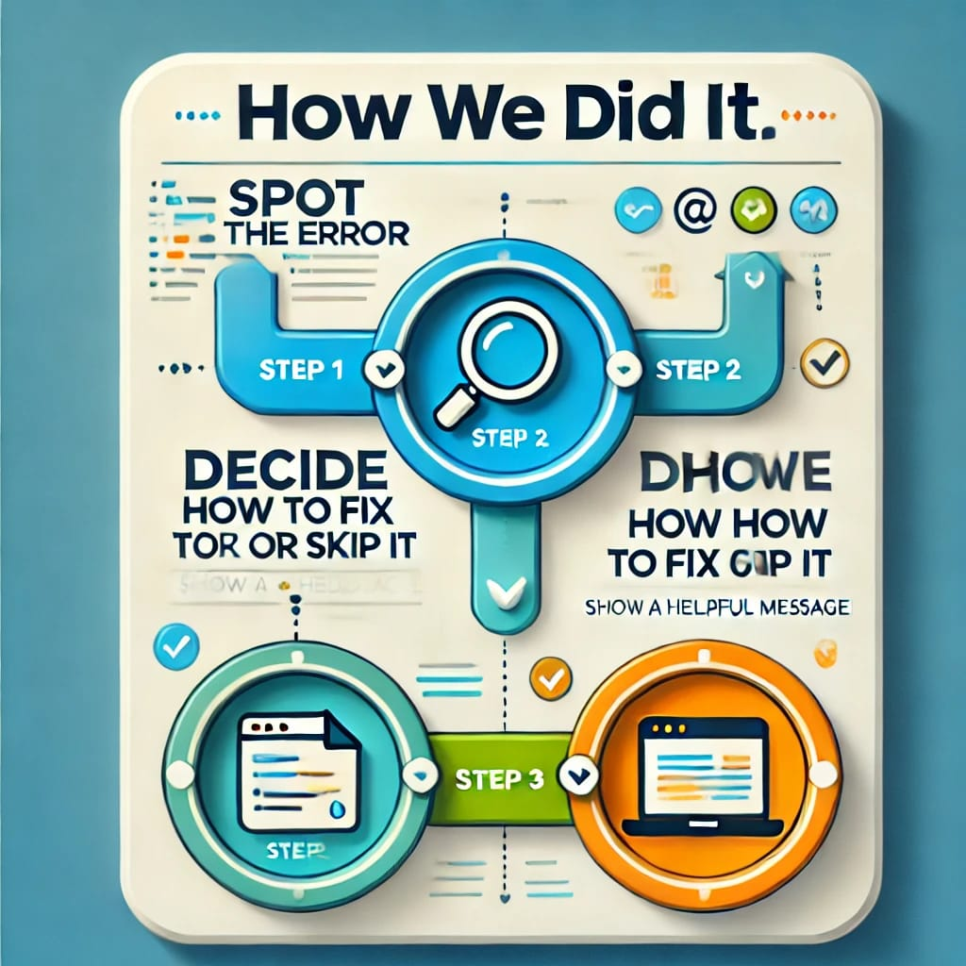
IMPLEMENTATION:
How We Did It
Step 1: Spot the error: The process begins by detecting any issues or mistakes in the code or input.
Step 2: Decide how to fix or skip it: A judgment is made on whether to correct the error automatically or bypass it based on predefined rules.
Step 3: Show a helpful message: A clear and useful notification is displayed to inform the user about the error and the action taken.

Slide 14

RESULTS AND DISCUSSION:
What We Found
Tested it with code that has mistakes: The system was evaluated using intentionally flawed code to assess its error-handling capabilities.
It kept going better than old models: It performed more reliably and efficiently compared to previous versions or traditional approaches.
Messages were easier to read: The output messages were clearer and more user-friendly, improving understanding and interaction.

Slide 15
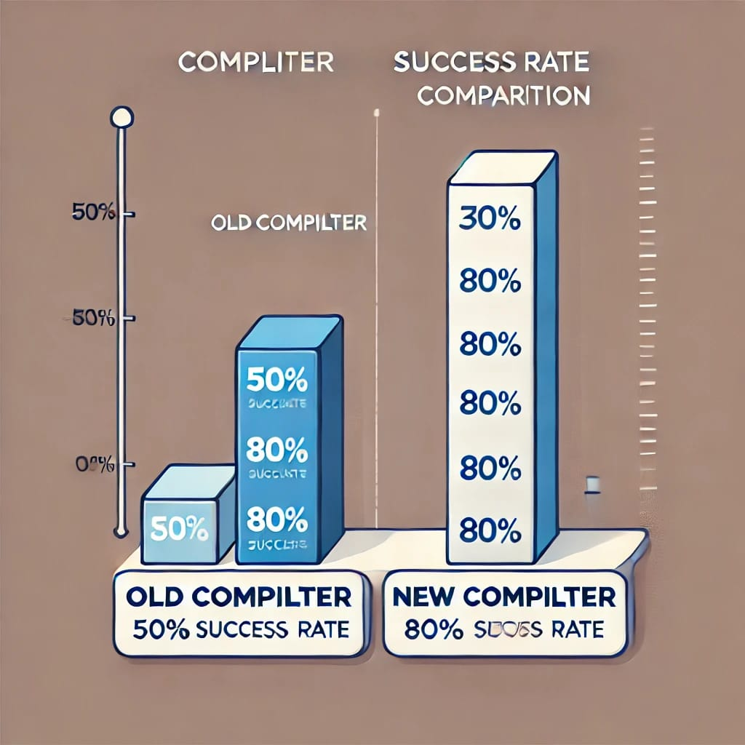
RESULTS AND DISCUSSION:
Comparing to Others
Old compilers stopped 50% of the time: They failed half the time, showing low reliability.
Ours only stopped 20% of the time: Ours succeeds 80% of the time, proving better performance.
Faster and more helpful for users: Fewer stops mean quicker, user-friendly operation.

Slide 16

FUTURE ENHANCEMENTS:
Making It Better
Add smart tech (like AI) to guess fixes: Integrate AI to predict and suggest code corrections automatically.
Work with more coding languages: Expand compatibility to support a broader range of programming languages.
Make it super fast for big projects: Optimize performance to handle large-scale projects with speed.

Slide 17
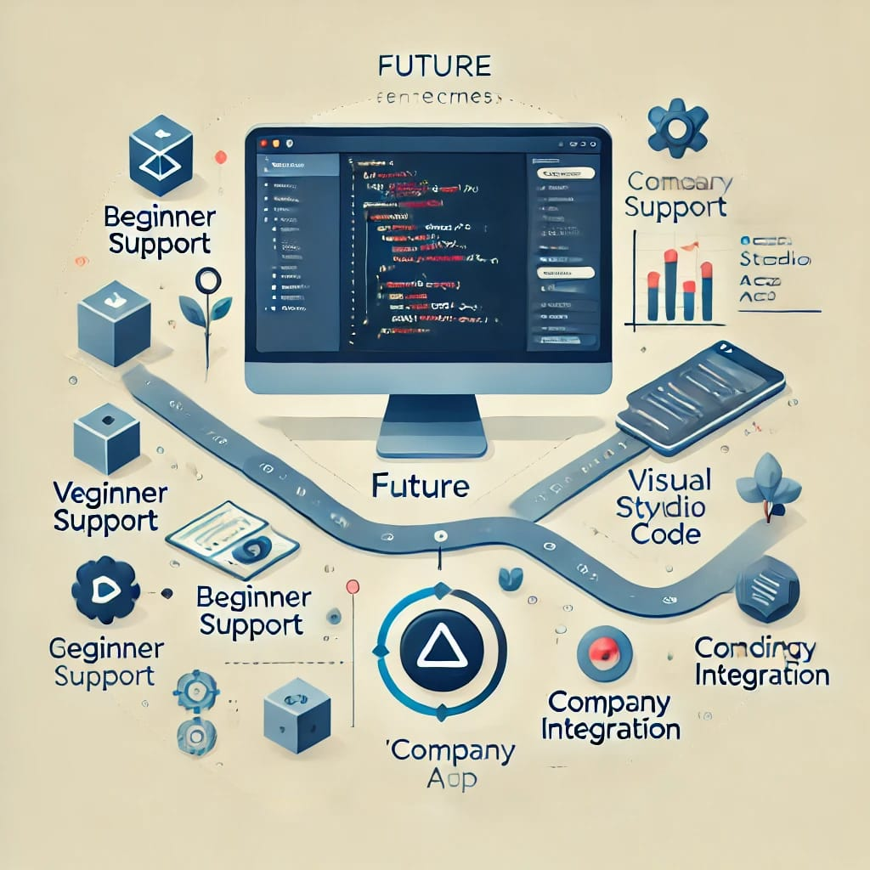
FUTURE ENHANCEMENTS:
Where It Can Go
Use it in coding apps (like VS Code).
Help beginners learn by fixing errors.
Share it with companies for real use.

Slide 18

CONCLUSION:
We made compilers tougher with better error fixes.
It finds errors, keeps going, and helps users.
Beats old ways in tests.
Why It’s Cool!
Saves time for coders.
Works on big and small projects.
Ready for more upgrades later.

Slide 19
THANK YOU☺

